Slide 1
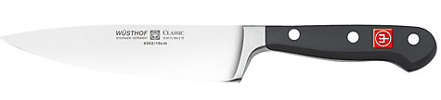
KITCHEN KNIFE
Brand: Wusthof
Country of Origin: Germany
Dimensions: L16cm
Finish: Polished
Guarantee: Lifetime
Handle Type: Riveted
Blade Material: Stainless steel

Slide 2
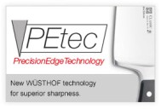
KITCHEN KNIFE
Wusthof Classic Kitchen Knife
Wusthof have been producing knives since 1814 at their factory of skilled workers in Solingen, the famous home of Germany's knife industry.
The most essential knife in any kitchen. Designed for slicing, mincing and dicing all kinds of food.
The Classic kitchen knife range from Wusthof combines professional quality with design.
A classic three-riveted handle for outstanding comfort and a secure grip, every knife is forged from a single blank of steel to ensure perfect balance and ultimate strength.
The PrecisionEdge technology (PEtec) on the cutting edge of the knife ensures long-lasting sharpness.
Precision-forged in high-carbon chromium molybdenum-vanadium stainless steel and finished to meticulous standards, This Wusthof knife will last a lifetime of the heaviest use and come up sharp every time.
Lifetime guarantee
Wusthof PEtec – PrecisionEdge technology
The blades are measured before sharpening using lasers.
Computers calculate the precise sharpening angle for each blade.
Precision robots sharpen the blades on a whetstone.
The knives are given a final polish using an ultra high grade polishing disc giving a long lasting, mirrored finish.

Slide 3
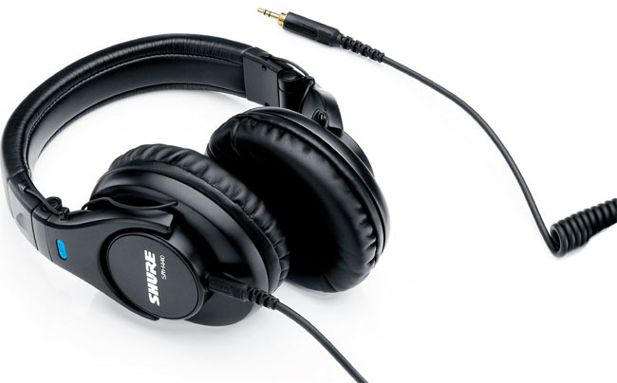
HEADPHONES
Brand: Shure
Model: SRH440
Perfect for Home & Studio they reproduce audio accurately over an extended range
Impedance and power handling optimised for performance with professional audio devices
Adjustable headband and collapsible construction provide comfort and portability
Detachable coiled cable that locks securely into the ear cup
Includes threaded 1/4" gold-plated adapter, carrying bag, and user guide

Slide 4
SHURE HEADPHONES
Shure SRH440 professional studio or home headphones
Shure have been leaders in the audio technology industry for over ninety years and they are famous for their commitment to strong, high quality, durable audio equipment.
The Shure SRH440 headphones feature neodymium dynamic drivers so they can deliver accurate audio across an extended range. Optimised impedance and power handling mean the SRH440 headphones can deliver great performance across a range of professional audio devices such as mixing consoles, headphone amplifiers and DJ mixers as well as being perfect for personal use.
The SRH440s feature a closed back, circumaural design which minimises background noise so you can enjoy undiluted, even and accurate sound reproduction whether you’re in the studio or on the go.
Featuring the strong, durable build you expect from Shure, the SRH440s also have a detachable cable and replaceable earpads so you can easily replace these components without having to replace the entire set of headphones.
The large, soft earpads and adjustable headband mean you can get hours of extended use while comfortably wearing the headphones and their collapsible design means they’re well suited for portability – they even come with a carry pouch for extra protection.
Shure SRH440 Professional Studio or Home Headphones Features:
Enhanced frequency response to deliver accurate audio across an extended range
Optimised impedance and power handling for performance with professional audio devices
Adjustable headband and collapsible construction for enhanced comfort and portability
“Bayonet clip” securely locks the detachable cable into the ear cup
Supplied with a ¼” (5.3mm) gold plated adapter to ensure further compatibility and high performance.

